Slide 1
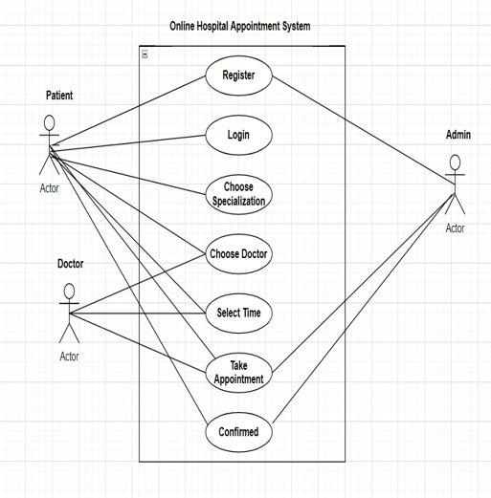
E-HOSPITAL MANAGEMENT SYSTEM
Online Hospital Appointment System is to provides an easy way of booking a doctor’s appointment from their house via smart phone, laptop, computer and any other web connected device.
The need for healthcare services is growing with the increase in population and the number of patients who seek health care at hospitals, medical facilities, holistic groups, and physicians practice has improved significantly.
These bring a new set of challenges for the staff of the facility and administrators. Online Hospital Appointment System Software, a recent technological advancement, has made the booking process in hospitals easier for both patients and administrative staffs.
H

Slide 2
Outcomes:-Online Hospital Appointment System is one of the most commonly used web based application and enables individuals to securely and conveniently book their appointment from their house via laptops , smart phones , computer and any other web connected devices.
Time Saving:- The staff spends less time on managing appointments, and phone booking, and can, therefore, use their free time for more urgent and vital tasks. The patients can also save time as there is no need for calling the hospital and booing an appointment in the middle of their busy schedule.
Monetary Savings:-The time savings made by the facility can translate automatically into monetary savings as a reduction in services and staff translates into a reduction in expenses. The Online Hospital Appointment System can reduce the need for extra human resources created by the process of appointment scheduling.

Slide 3
24 Hours Convenience:-An individual is needed to schedule an appointment over the phone calls during the office hours, and therefore people need to work round the clock on the phone booking. With Online Appointment System, the individual or the patient can book an appointment any time. It is seen that after business hours there is more than 55 percent of all appointments booked through Online Appointment System.
Online Payment:-Every service need a secure payment system. As an online appointment system is safe , and the data is kept secure, people find themselves comfortable with online payments. Healthcare provides are making use of the latest technology and keeping themselves updated to enhance quality. The Online Appointment System is considered to be a step forward to bring a healthcare facility to the future.

Slide 4
Project Outline:-
The Online Hospital Appointment System is mainly used for patients who want take doctor’s appointment without going outside from their house via smart phone, laptop, computer, and any other web connected device.
If any patient want to take appointment from the doctor first of all they need to register through Online Hospital Appointment System Software. After registration, register candidate get a patient id through gmail. After receive id they need to login using same id then system shows different departments. Whenever they select which department they want it shows doctor’s list. Now they need to select doctor and set time and book appointment. Before you book the appointment system asks confirmation details they need to confirm it. After confirmation they receive booking confirmation through gmail.
We have another option here if any patient want to cancel the appointment they can easily cancel the appointment using this software.

Slide 5
we upload the hospital staff,managment details ,equipments,and along with that hospital is capable for major operations are not.we have to upload the consultancy fees of different hospitals and some multispeciality hospitals also contains in-built diagonistics so we have to upload the amount also for major tests like cancer,ulcer,heart holes.
we made video consultency with doctors,if in case doctors are not available in that moment nurses can talk and handle the casesheet upto doctor arrive.we also develop the medicines cart and free home delivery.......according to doctors prefeered prescription.we have to implement some health insurance policy with according to hospitals terms and conditions.if the user is repeated customer to the particular hospital and we have to implement health insurance policy's to attract the user's.
Here in medicines so much of fraud is going on the same quantity of medicine suppose paracetmol is the component we have used it in different names for ex:-dolo 650,sinerst,zeredol-p all these tablets contains same component but different doctors prefeered different products for their remunirations by using these products .....so that we delivery the medicines according to doctor prescripition.
finally you may already so many medicalapps like Epocrates,medscape,phrameasy,Mfine,Exicomp,VisualDx and Practo etc....so many apps why would you preffer this app,we have give ben ificarys like first consultancy in my app is free and concessions on medicines according to number of times.
we have to take the reviews from the end-users and kept below it......then user can finds the good doctor.we will provide the diagonsticts test reports within 10hrs through online only through app. we can hide the data of the user for security.
free home delivery of vaccination and cost for those nurses visit the location and injecting the vaccine.
we have link the company's which are providing the medical equipment to the hospitals for better maintainence of the hospital equipments for the patients purpose.
According to that cases we have to implement the best doctors on the top in our websites .for all this first of all we need nth number of users .we provide free facilites when we launch the product upto 3months then only users can be increased.so first consultancy fees can be paid by ours which is applicable for some hospitals for multispeciality hospitas 50% off.
we provied concessions on first order of medicines,diagonstics tests, and later implements the health insurance policys.some regular users who meet with an accident we provide some relief fund/concession for that operations..
we have to mention the equipments company name generally used in that hospitals suppose ecg provided vmwarecompany,we have mention it ecg equipments from which company .we have to maintain the direct link to the equipment company from request of hospital requirments we have to mention the hospital requirments about the equipment to that company through quotations.

Slide 6
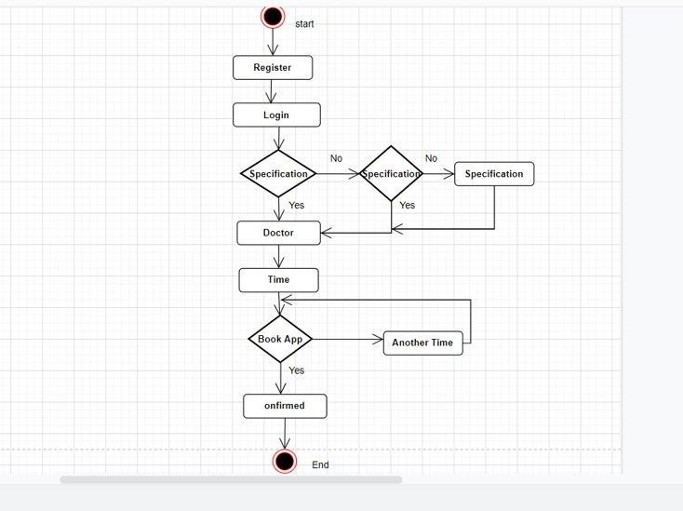
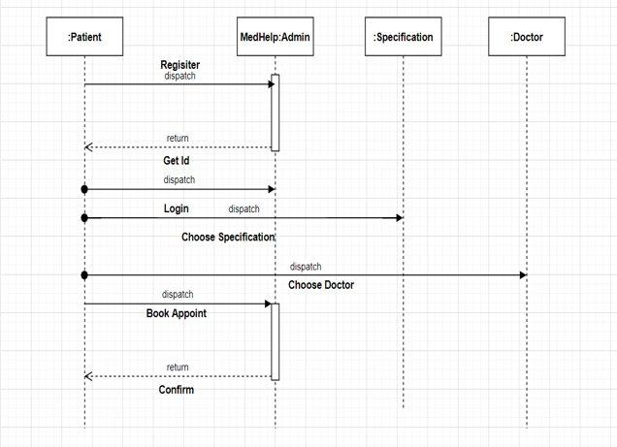

Slide 7

HOMEPAGE:-

Slide 8
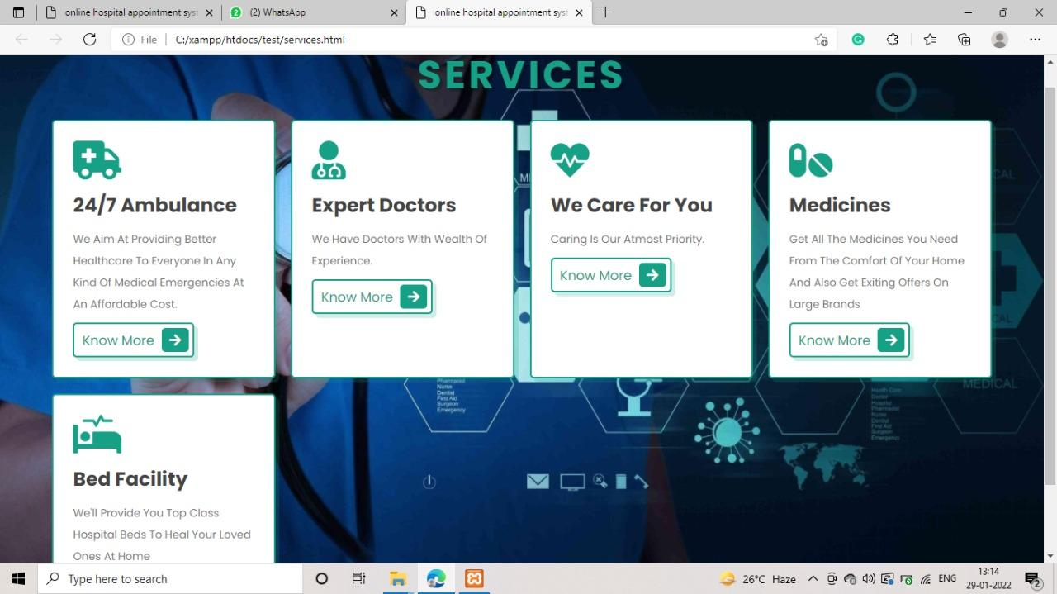

Slide 9
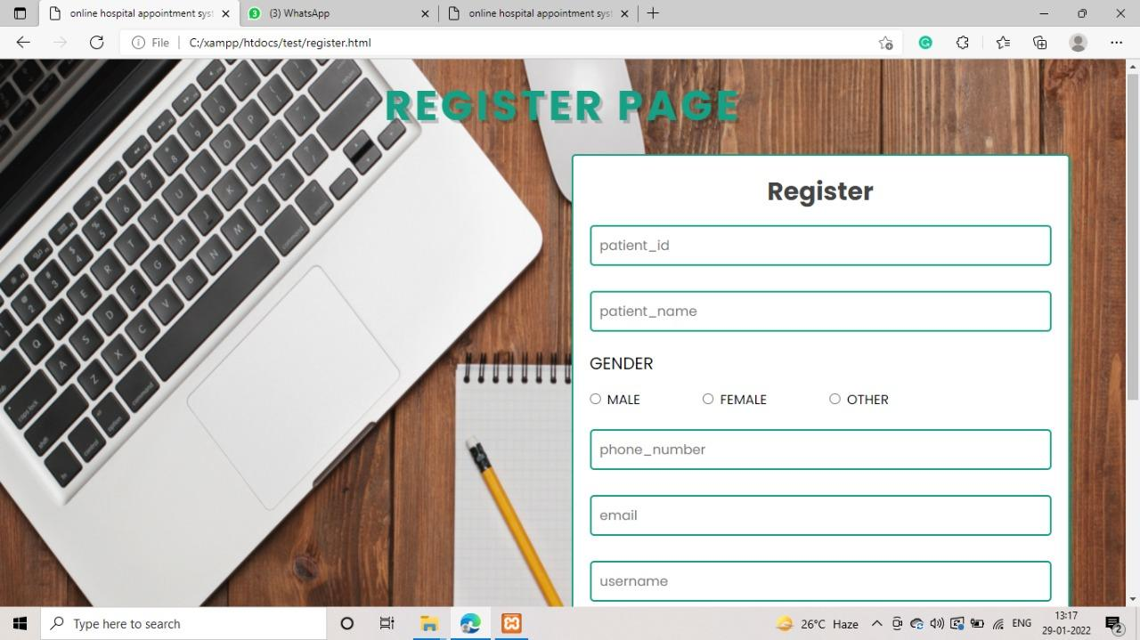

Slide 10
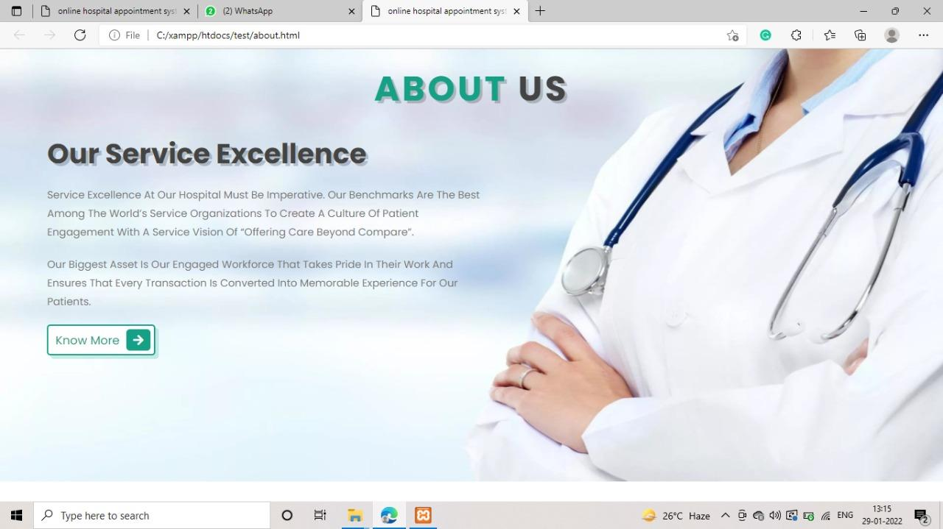
About Us page:-

Slide 11
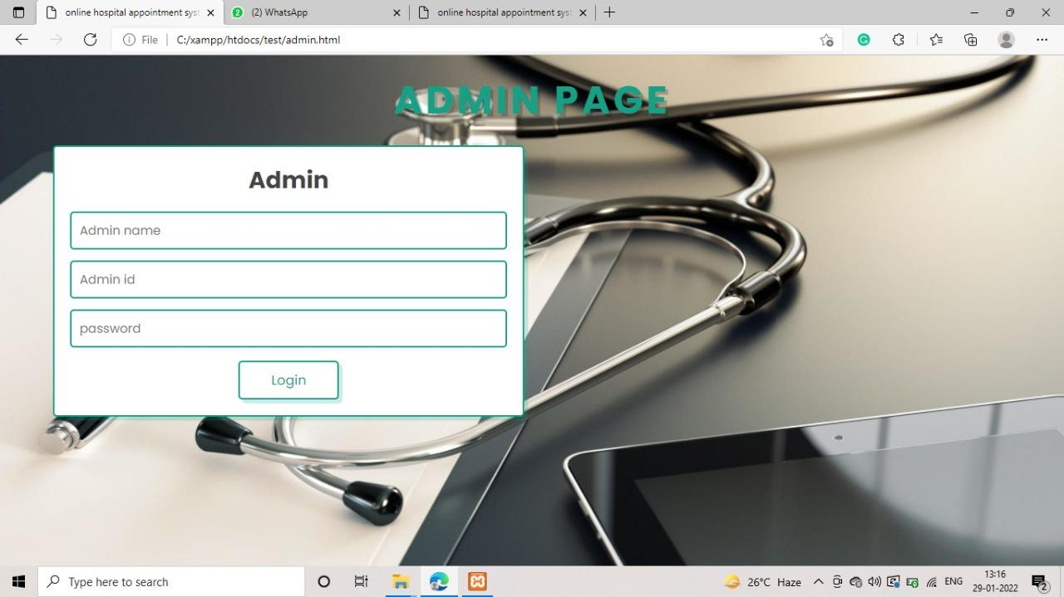
LOGIN PAGE:-

Slide 12
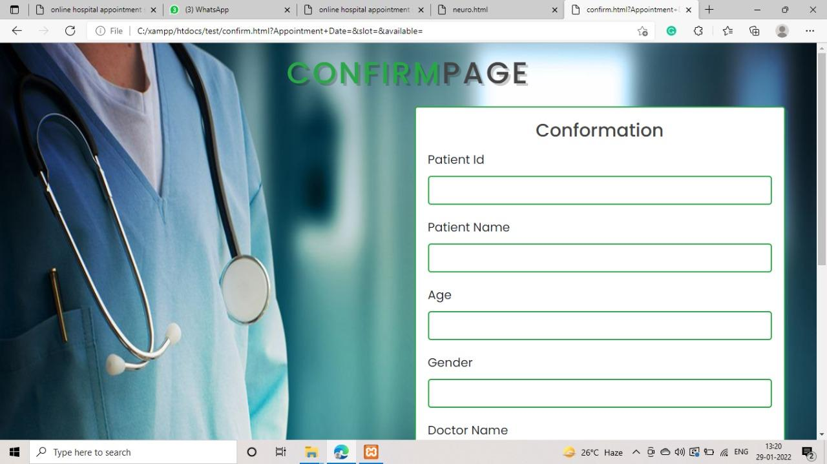
Confirmation page:-

Slide 13
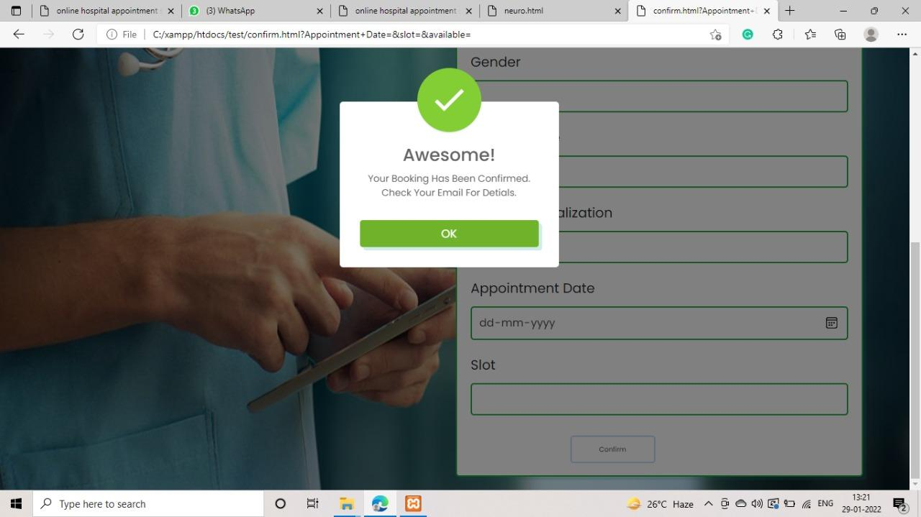
SUCCUSSES PAGE:-

Slide 14
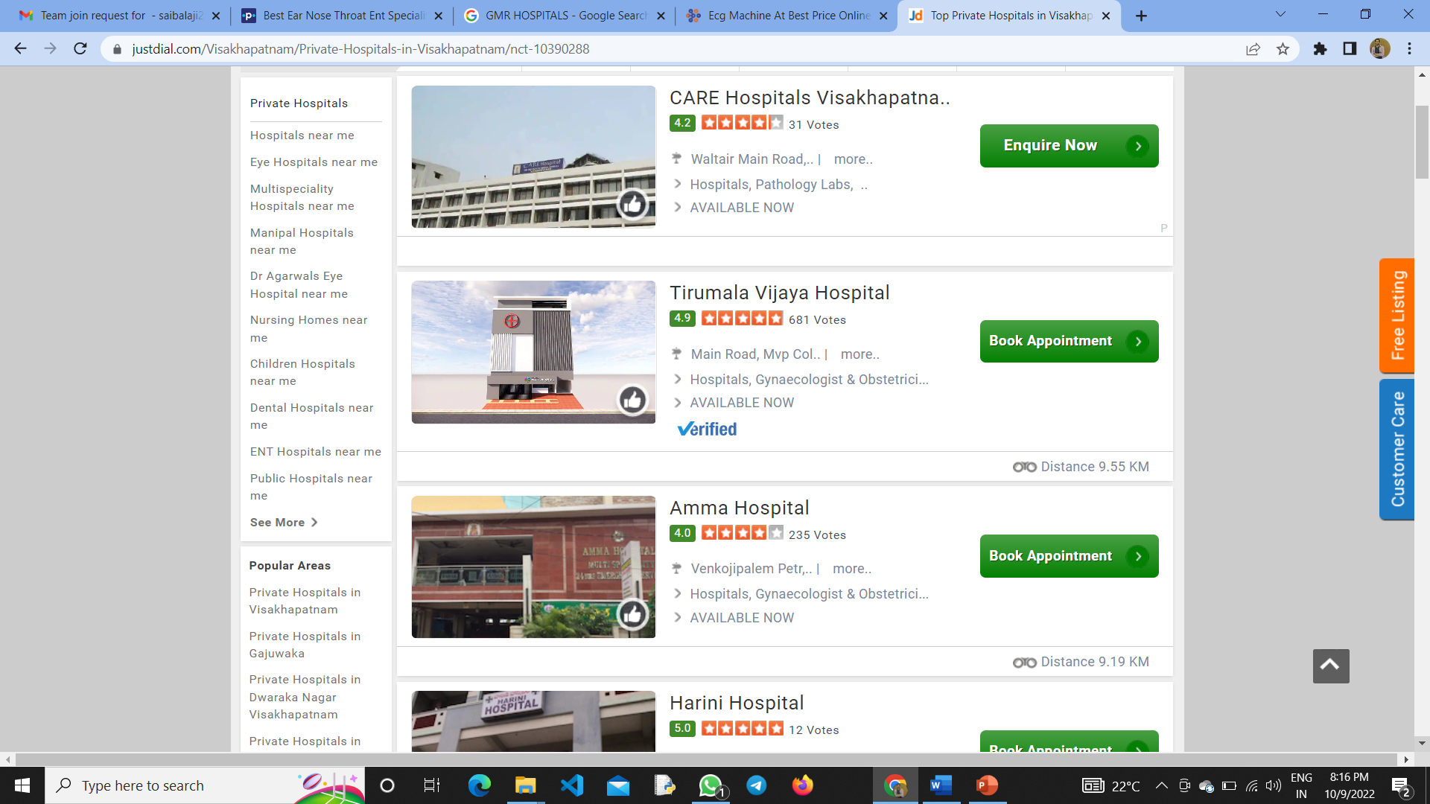
Starting page:-
When you click on decided hospitals accorinding to priorty we will book appointments of the doctors.

Slide 15
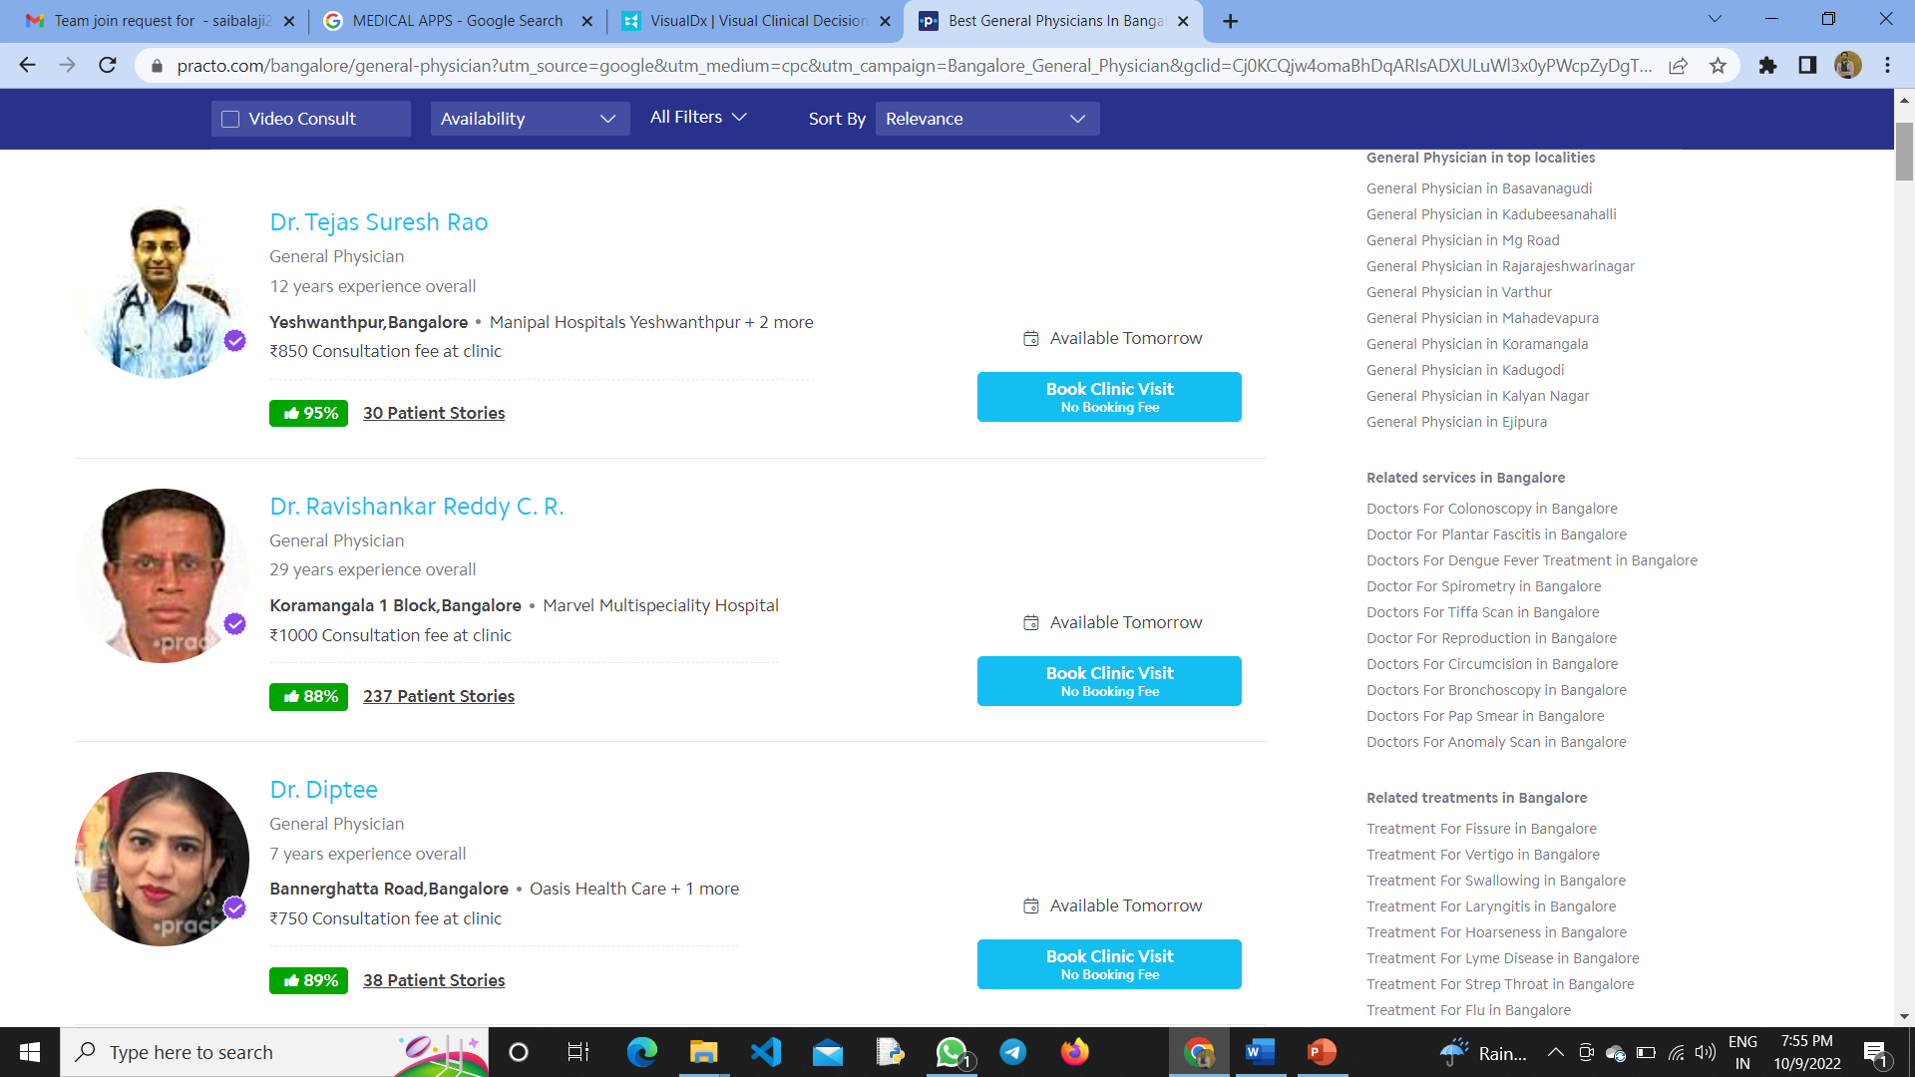
Doctors slide:-

Slide 16
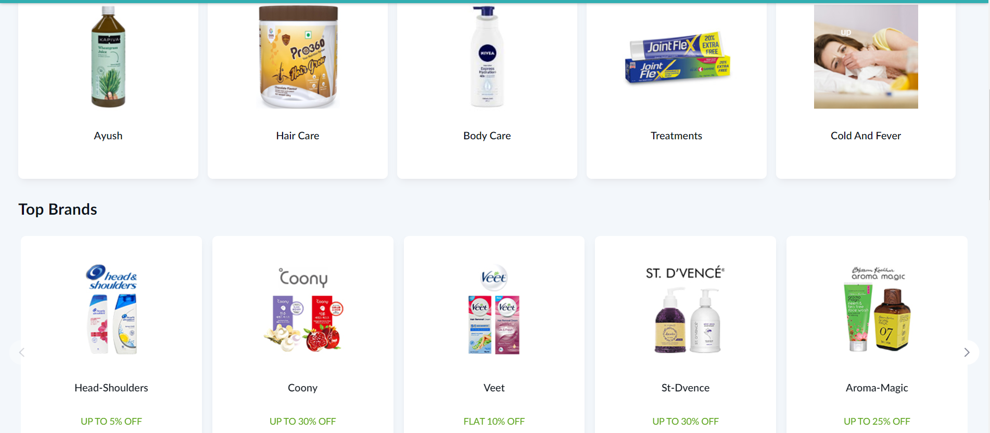
MEDICAL CART:-

Slide 17
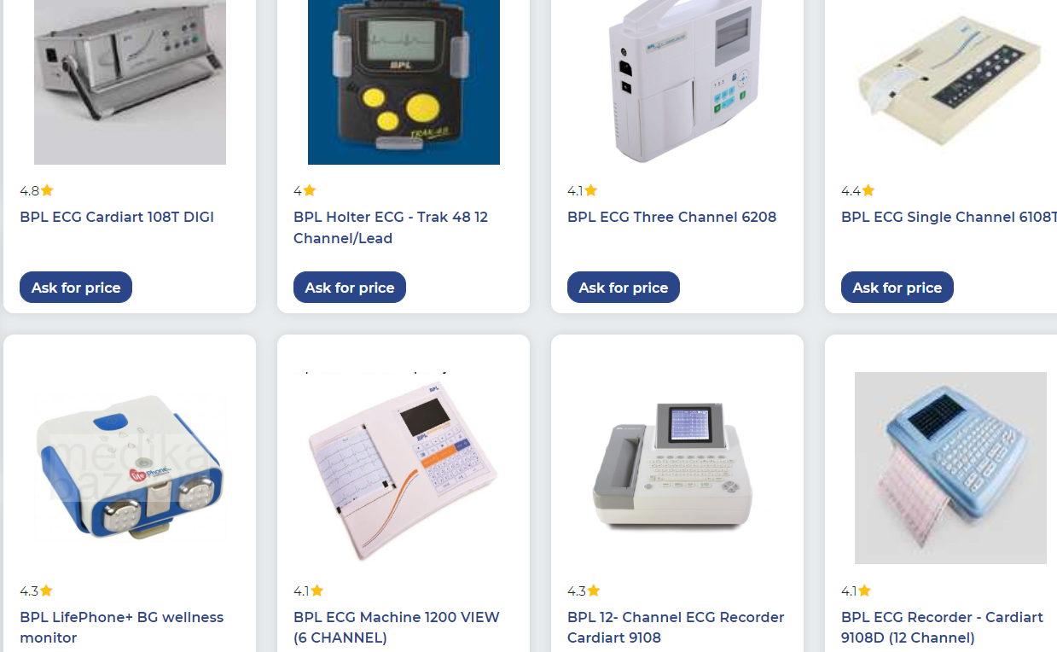
MEDICAL EQUIPMENT:-

Slide 18
Vaccination equipment:-

